Slide 1
Image compression in video games
Jairo Miguel Marulanda Giraldo

Slide 2
Maybe you need to divide the content
Old on New
Cloud gaming
Why Do Old Game Consoles Look So Bad on Modern TVs?
Image compression applied in game streaming

Slide 3
Old on New

Slide 4
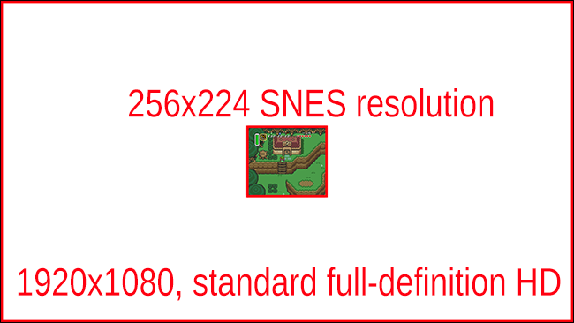
Resolutions Don’t Match Up

Slide 5


Slide 6


Slide 7
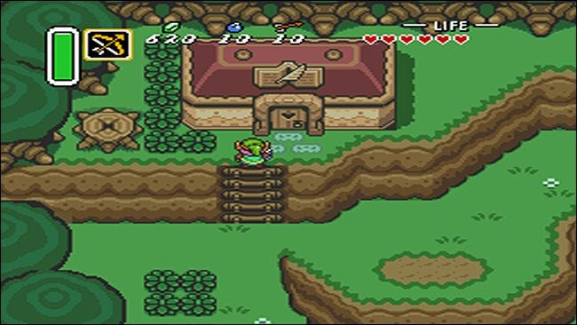
Aspect Ratio Problems

Slide 8

Other issues
bloom phosphor effect
Scanlines
240p signals sometimes aren’t even supported on modern TVs
The low resolution didn’t affect CRT televisions

Slide 9

Solutions
digital downloads
handle upscaling on the game console
emulation

Slide 10
Cloud gaming

Slide 11

What is
In cloud gaming systems, the game program runs at servers in the cloud, while clients access game services by sending input events to the servers and receiving game scenes via
video streaming.

Slide 12

Motivation
Remote rendering is motivated by the need to allow thin clients to display graphics efficiently by migrating rendering tasks to remote servers.

Slide 13

Video streaming approach
It is a post-rendering video streaming technique; in one way it encodes the game screens as video steaming,
and in another it uses graphics command semantics to assist the encoding.

Slide 14

Graphics streaming approach
game execution occurs at the servers, and graphics commands are captured and transmitted to clients for screen renderings. Its main limitation is that it is very bandwidth consuming.

Slide 15

Live Render
LiveRender reduces transmission bandwidth by compressing graphics data and using caches. Caching is aimed to reduce redundant transmission by replacing reusable data structures with short references.

Slide 16

Alternatives
Xbox Game Pass (Xbox One, *PC)
PlayStation Now (PS4, PC)
GeForce Now (PC, Mac, Nvidia Shield)
Google Stadia
Shadow

Slide 17
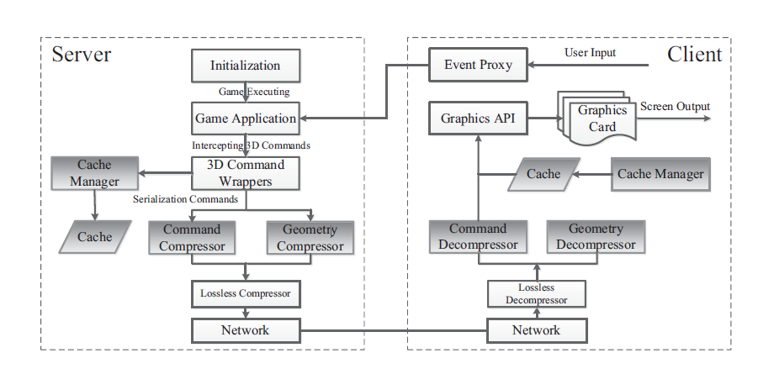

Slide 18
Bibliography
X. Liao et al., "LiveRender: A Cloud Gaming System Based on Compressed Graphics Streaming," in IEEE/ACM Transactions on Networking, vol. 24, no. 4, pp. 2128-2139, Aug. 2016, doi: 10.1109/TNET.2015.2450254.
Crider M. (2018). How to Geek: Why Do Old Game Consoles Look So Bad on Modern TVs?. Retrieved from
https://www.howtogeek.com/341543/why-do-old-game-consoles-look-so-bad-on-modern-tvs/
Gurwin J. (2021). Digitaltrends: The best game-streaming services for 2021. Retrieved from
https://www.digitaltrends.com/gaming/best-game-streaming-services/

Slide 19

Vielen Dank

